Slide 1
Porter Simulation Tool
Vitaliy Kondratiev
Nathan Johrendt
Mark Gammie
Tyler Lyn

Slide 2
The Stakeholders
Hamilton Health Sciences
Corey Stark (CSS - Sodexo Systems and PerformanceManager)
Kym Kempf (Business and ProgramManager - Corporate Services)
David DiSimoni (SiteManager - Customer Support Services)
Anita Lamond (Director - Corporate Services)
Steve Metham (Manager - Quality)
Mohammad Majedi (Quality Specialist)
Talha Hussain (Quality Specialist)

Slide 3
The Problem
Porters are key piece of the overall patient experience
HHS are experiencing inefficiencies in their porter services
Porters should be able to achieve greater efficiency
Minimization of client wait times
Reduce total time wasted in operations
There is a need for empirical evidence to support/disprove new ideas or initiatives

Slide 4
The Requirements
Easy to operate
Quick to execute
Provide relevant results data

Slide 5
The Scope
Up to 7 day simulation
Concentrate of porter wait times
Exclusive use of real world statistical data
Mimicking of the dispatching system

Slide 6
Design Overview
Extremely streamlined work flow
Basic Interface Settings → Input of Data Files → Statistical Graphs

Slide 7
Demo

Slide 8
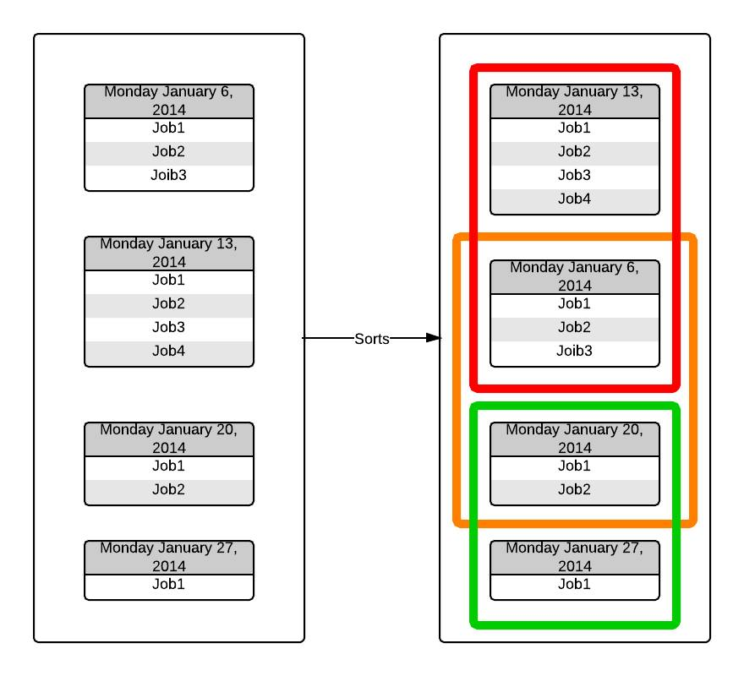
The Simulation Data Sampling

Slide 9
The Dispatcher Design
Based off the requirement documentation provided by HHS
Algorithm that organizes pending jobs assigning each a Dispatch Value (DV)
Job with the highest Dispatch Value in the queue will be assigned to the next available porter
Dispatcher will increase the job priority of each job in its queue over a configurable amount of time
Dispatch Value = Job Priority * Appointment Factor

Slide 10
Future
Convert the software to a web application with
Allow other members of HHS to use the software without

